Slide 1
Chapter 3
The essential JavaScript statements

Slide 2
Objectives (part 1)
Applied
Given the specifications for a JavaScript application that requires only the skills that you’ve learned so far, code, test, and debug the application.
Knowledge
Describe the rules for evaluating a conditional expression that consists of relational operators, including the use of the isNaN() method.
Describe the use of the logical operators and the rules for evaluating a compound conditional expression, including order of precedence and the use of parentheses.
Describe the flow of control for an if statement that has both else if and else clauses.

Slide 3
Objectives (part 2)
Describe two ways that you can code a conditional expression that tests whether a Boolean variable is true.
Describe the flow of control for while, do-while, and for loops.
Describe the use of a JavaScript array, including the use of indexes and the length property of an array.
Describe the use of a for, for-in, and for-of loop for processing each element in an array.

Slide 4
The relational operators
Operator Name
== Equal to
!= Not equal to
> Greater than
< Less than
>= Greater than or equal to
<= Less than or equal to

Slide 5
Conditional expressions
lastName == "Hopper"
testScore == 10
firstName != "Grace"
months != 0
testScore > 100
age < 18
distance >= limit
stock <= reorder_point
rate / 100 >= 0.1

Slide 6
The syntax of the global isNaN() method
isNaN(expression)
Examples of the isNaN() method
isNaN("Hopper") // Returns true
isNaN("123.45") // Returns false

Slide 7
The logical operators
Operator Name Description
&& AND Returns a true value if both expressions are true. This operator only evaluates the second expression if necessary.
|| OR Returns a true value if either expression is true. This operator only evaluates the second expression if necessary.
! NOT Reverses the value of the Boolean expression.

Slide 8
Conditional expressions with logical operators
Example 1: The AND operator
age > 17 && score < 70
Example 2: The OR operator
isNaN(rate) || rate < 0
Example 3: The NOT operator
!isNaN(age)
The order of precedence for the logical operators
NOT operator
AND operator
OR operator

Slide 9
Terms related to conditional expressions
conditional expression
relational operator
compound conditional expression
logical operator
order of precedence
short-circuit operator

Slide 10
The syntax of the if statement
if ( condition-1 ) { statements }
[ else if ( condition-2 ) { statements }
...
else if ( condition-n ) { statements } ]
[ else { statements } ]
An if statement with an else clause
if ( age >= 18 ) {
alert ("You may vote.");
} else {
alert ("You are not old enough to vote.");
}

Slide 11
An if statement with else if and else clauses
if ( isNaN(rate) ) {
alert ("You did not provide a number for the rate.");
} else if ( rate < 0 ) {
alert ("The rate may not be less than zero.");
} else if ( rate > 12 ) {
alert ("The rate may not be greater than 12.");
} else {
alert ("The rate is: " + rate + ".");
}

Slide 12
An if statement with a compound conditional expression
if ( isNaN(userEntry) || userEntry <= 0 ) {
alert ("Please enter a valid number greater than zero.");
}

Slide 13
How to test a Boolean value
To see if it’s true
if ( isValid == true ) { }
if ( isValid ) { } // same as isValid == true
To see if it’s false
if ( isValid == false ) { }
if ( !isValid == true ) { }
if ( !isValid ) { } // same as !isValid == true

Slide 14
The syntax of a while loop
while ( condition ) { statements }
A while loop that adds the numbers 1 through 5
let sum = 0;
let i = 1;
while (i <= 5) {
sum += i; // adds i to sum
i++;
}
alert(sum); // displays 15

Slide 15
A while loop that makes sure a user enters a positive number
let years = parseInt(prompt("Enter number of years."));
while ( isNaN(years) || years <= 0 ) {
years = parseInt(prompt(
"Years must be a valid positive number."));
}

Slide 16
The syntax of a do-while loop
do { statements } while ( condition );
A do-while loop that makes sure a user enters a positive number
let years = null;
do {
years = parseInt(prompt("Enter number of years.\n" +
"(Must be valid positive number)"));
}
while ( isNaN(years) || years <= 0 );

Slide 17
The syntax of a for statement
for ( counterInitialization; condition; incrementExpression ) {
statements
}
A for loop that adds the numbers from 1 through 5
let sum = 0;
for ( let i = 1; i <= 5; i++ ) {
sum += i; // adds i to sum
}
alert(sum); // displays 15

Slide 18
A for loop that calculates the future value of an investment
const investment = 10000;
const annualRate = 7.0;
const years = 10;
let futureValue = investment;
for ( let i = 1; i <= years; i++ ) {
futureValue += futureValue * annualRate / 100;
}
alert(futureValue.toFixed(0)); // displays 19672
Other ways that the future value calculation could be coded
futureValue = futureValue + (futureValue * annualRate / 100);
futureValue = futureValue * (1 + (annualRate / 100))

Slide 19
A for loop that increments the counter by two
for ( let i = 0; i <= 10; i += 2 ) {
document.write(i + " ");
}
// displays 0 2 4 6 8 10
A for loop that decrements the counter
for ( let i = 3; i > 0; i-- ) {
document.write(i + "...");
}
document.write("Blast off!");
// displays 3...2...1...Blast off!

Slide 20
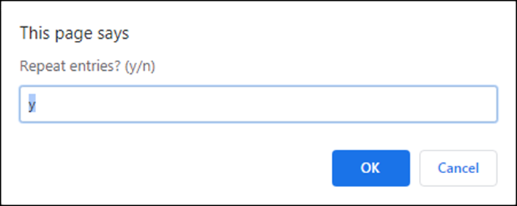
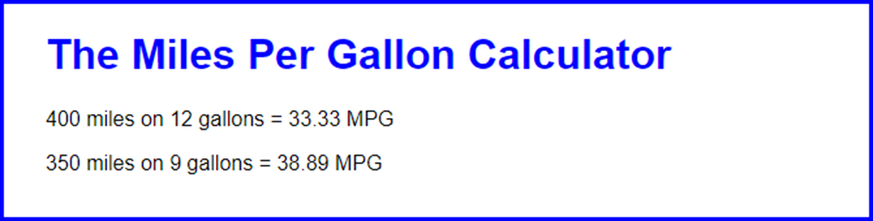
The prompt dialog for continuing the MPG application
The MPG application in the browser with two calculations

Slide 21
The body element for the MPG application
<body>
<main>
<h1>The Miles Per Gallon Calculator</h1>
<script src="mpg.js"></script>
</main>
</body>

Slide 22
The mpg.js JavaScript file
let again = "y";
do {
const miles = parseInt(prompt("Enter miles driven"));
const gallons = parseInt(prompt("Enter gallons of gas used"));
if (miles > 0 && gallons > 0) {
const mpg = parseFloat(miles/gallons);
const html = `<p>${miles} miles on ${gallons}
gallons = ${mpg.toFixed(2)} MPG</p>`;
document.write(html);
}
else {
alert("One or both entries are invalid");
}
again = prompt("Repeat entries? (y/n)", "y");
}
while (again == "y");

Slide 23
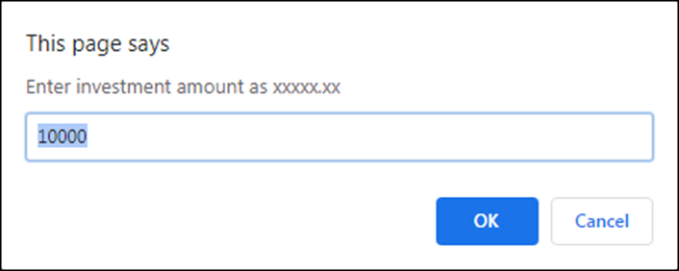
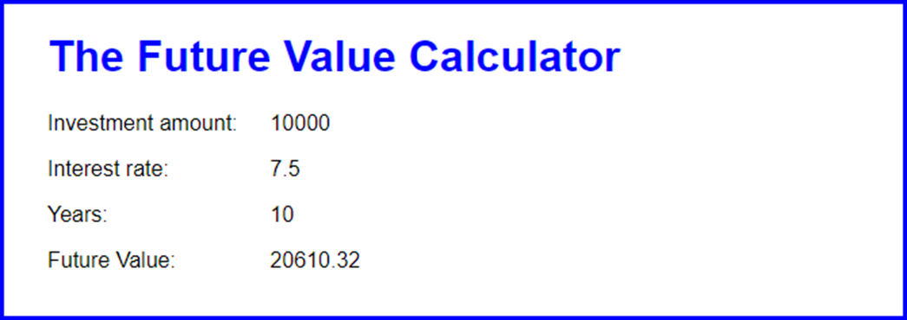
The first of three prompt dialog boxes for the Future Value application
The results in a browser

Slide 24
The future_value.js JavaScript file (part 1)
let investment = 0;
do {
investment = parseFloat(
prompt("Enter investment amount as xxxxx.xx", 10000));
}
while ( isNaN(investment) );
let rate = 0;
do {
rate =
parseFloat(prompt("Enter interest rate as xx.x", 7.5));
}
while ( isNaN(rate) );
let years = 0;
do {
years = parseInt(prompt("Enter number of years", 10));
}
while ( isNaN(years) );

Slide 25
The future_value.js JavaScript file (part 2)
let futureValue = investment;
for (let i = 1; i <= years; i++ ) {
futureValue += futureValue * rate / 100;
}
document.write(`<p><label>Investment amount:
</label> ${investment}</p>`);
document.write(`<p><label>Interest rate:</label> ${rate}</p>`);
document.write(`<p><label>Years:</label> ${years}</p>`);
document.write(`<p><label>Future Value:</label>
${futureValue.toFixed(2)}</p>`);

Slide 26
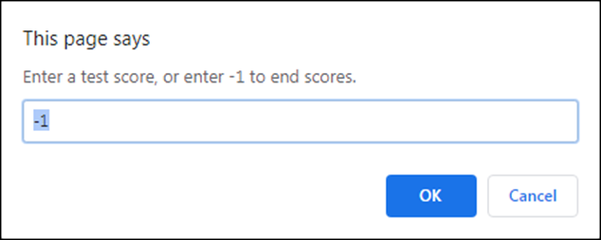
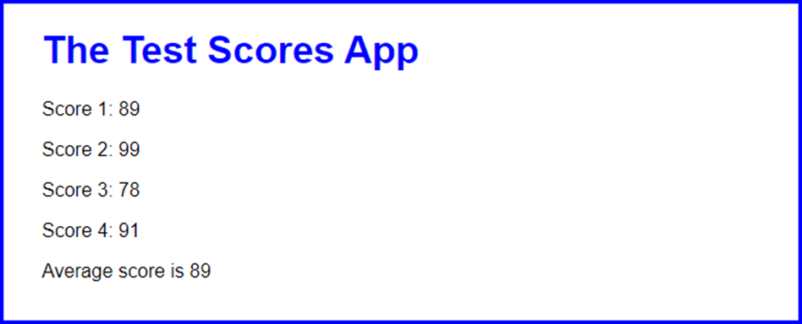
The prompt dialog box for the Test Scores application
The test scores in a browser

Slide 27
The test_scores.js JavaScript file (part 1)
let total = 0;
let count = 0;
let score = 0;
do {
// get a score from the user
score = parseInt(prompt(
"Enter a test score, or enter -1 to end scores.", -1));
// if it's valid, add to total, increment count,
// and display score
if (score >= 0 && score <= 100) {
total = total + score;
count++;
document.write(`<p>Score ${count}: ${score}</p>`);
}
// if user isn't ending scores, notify them of invalid data
else if (score != -1){
alert("Score must be a valid number from 0 through 100.");
}
}
while(score != -1);

Slide 28
The test_scores.js JavaScript file (part 2)
//calculate and display average score
const average = parseInt(total/count);
document.write(`<p>Average score is ${average}</p>`);

Slide 29
The syntax for creating an array
Using the Array() constructor and the new keyword
const arrayName = new Array(length);
Using an array literal
const arrayName = [];
A statement that creates an array
const totals = [];

Slide 30
The syntax for referring to an element of an array
arrayName[index]
Statements that refer to the elements in an array
totals[2] // refers to the third element – 411
totals[1] // refers to the second element – 212.25

Slide 31
How to add values to an array
Using individual statements
const totals = [];
totals[0] = 141.95;
totals[1] = 212.25;
totals[2] = 411;
Using a single statement
const totals = [141.95, 212.25, 411];

Slide 32
The syntax for getting the length property of an array
arrayName.length
A statement that gets the length of an array
const count = totals.length;
How to add a value to the end of an array
totals[totals.length] = 135.75;

Slide 33
Code that puts the numbers 1 through 10 into an array
const numbers = [];
for (let i = 0; i < 10; i++) {
numbers[i] = i + 1;
}
Code that displays the numbers in the array
let displayString = "";
for (let i = 0; i < numbers.length; i++) {
displayString += numbers[i] + " ";
}
alert (displayString); // displays 1 2 3 4 5 6 7 8 9 10

Slide 34
Code that puts four totals into an array
const totals = [];
totals[0] = 141.95;
totals[1] = 212.25;
totals[2] = 411;
totals[3] = 135.75;
Code that sums the totals in the array
let sum = 0;
for (var i = 0; i < totals.length; i++) {
sum += totals[i];
}

Slide 35
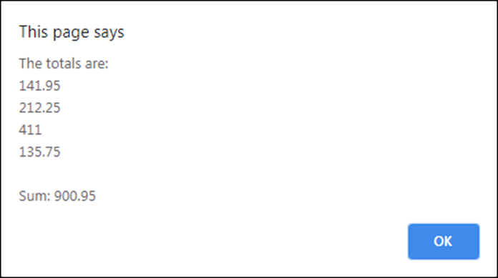
Code that displays the totals and the sum
let totalsString = "";
for (let i = 0; i < totals.length; i++) {
totalsString += totals[i] + "\n";
}
alert ("The totals are:\n" + totalsString + "\n" +
"Sum: " + sum);
The message that’s displayed

Slide 36
The syntax of the for-in loop
for ( indexInitialization in array ) {
statements
}
Code that totals the numbers in the array using a for-in loop
let sum = 0;
for (let i in totals) { // i holds the current index
sum += totals[i];
}
alert(sum); // displays 900.95

Slide 37
The syntax of a for-of loop
for ( valueInitialization of array ) {
statements
}
Code that totals the numbers in the array using a for-of loop
let sum = 0;
for (let val of totals) { // val holds the current value
sum += val;
}
alert(sum); // displays 900.95

Slide 38
Terms related to arrays
array
element
length of an array
array literal
index for an array
for-in statement
for-in loop
for-of statement
for-of loop

Slide 39

The result of the Test Scores application

Slide 40
The JavaScript for the enhanced Test Scores application (part 1)
// declare and initialize an array to hold test scores from user
const scores = [];
// use do-while loop to get scores from the user and store in array
let score = 0;
do {
score = parseInt(prompt(
"Enter a test score, or enter -1 to end scores", -1));
if (score >= 0 && score <= 100) {
scores[scores.length] = score;
}
else if (score != -1){
alert("Score must by a valid number from 0 through 100");
}
}
while(score != -1);

Slide 41
The JavaScript for the enhanced Test Scores application (part 2)
if (scores.length > 0) {
// use a for-in loop to add each score to total and display it
let total = 0;
for (let i in scores) {
total = total + scores[i];
document.write(
`<p>Score ${parseInt(i) + 1}: ${scores[i]}</p>`);
}
//calculate and display the average
const average = parseInt(total/scores.length);
document.write(`<p>Average score is ${average}</p>`);
}

